Slide 1
Project Title: SDN oriented DDoS Blocking scheme with Honeypot Security mechanism
Student’s Name: Garvit Chawla
Course : TELE6400 (SDN), Semester: Fall-2017
Professor’s Name: Prof. Dr. Bhumip KHASNABISH
Presentation Date, Location & Time: 20:00 - 12/12/17
160, Richards Hall, NEU

Slide 2
Outline
Abstract and Summary
Main Focus of the Project
Survey of Previous works
Distinction of the Current Work
Usefulness of the Current Work
Simulation/Emulation Details
Results
Future works
Q&A and Discussion
References
Background and Other Information

Slide 3
Abstract and Summary
Software-Defined Networking (SDN) is an emerging paradigm that promises to change the hard-to-manage state of affairs by dividing the network’s control plane from the data plane, thereby promoting logical centralization of network control and introducing the ability to program the network.
DDoS attacks has been labelled as the biggest risk to internet security today as they compromise the server.
A method is built on the server side to discern among users such that service to genuine legitimate users is not disturbed when a server is attacked.
SDN can make the network easily configurable to build a strong shield against skillfully prepared DDoS attacks.
The DDOS blocking scheme has been implemented as a SDN application that runs on a SDN controller, POX.
The code is written in Python and is tested through emulation on Mininet, where it will be shown that DDoS attack is effectively blocked using Honeypot Security mechanism.
A CAPTCHA/reCAPTCHA or a javascript challenge mode to be implemented in the future on the server under attack such that service to genuine legitimate users is not disturbed.

Slide 4
Main Focus of the Project
DDoS attacks are termed as the biggest threat to the security of internet today, they target a specific service, mobilizing only a small amount of legitimate looking traffic to compromise the server. Detecting or stalling such clever attacks by only using inconsistent traffic statistics has become difficult and devising countermeasures has been mostly left to the victim server.
1. In this project, a DDoS attack detection and mitigation application is implemented in an SDN environment.
2. Additionally, a mechanism is developed on the server side to discern between legitimate and illegitimate users such that service to legitimate users is not affected.

Slide 5
Survey of 5 Previous Similar Works 1/5
J. H. Jafarian, E. Al-Shaer, and Q. Duan, “OpenFlow Random Host Mutation: Transparent Moving Target Defense using Software Defined Networking,” Proc. ACM HotSDN, pp. 127-132, 2012.
The paper proposed to mutate the server address frequently so that the network scanning prior to attack delivers an address of the victim that will be invalidated at the time of the attack. But this scheme requires support from external network components such as DNS, and is not scalable.

Slide 6
Survey of 5 Previous Similar Works 2/5
R. Braga, E. mota, and A. Passito, “Lightweight DDoS Flooding Attack Detection Using NOX/OpenFlow,” Proc. IEEE LCN, pp. 408-415, 2010.
The paper discusses how to detect DDoS attacks in SDN. In the proposed scheme, the detection application on the NOX controller computes six features by obtaining flow statistics from switches through the OpenFlow interface. A shortcoming of the scheme, however, is that it assumes IP address spoofing by the attacker.

Slide 7
Survey of 5 Previous Similar Works 3/5
Lim, S.; Ha, J.; Kim, H.; Kim, Y.; Yang, S., "A SDN-oriented DDoS blocking scheme for botnet-based attacks," Ubiquitous and Future Networks (ICUFN), 2014 Sixth International Conf on , vol., no., pp.63,68, 8-11 July 2014.
This paper proposes a DDoS blocking scheme applicable to a SDN-managed network. The scheme requires communication between the DDoS blocking application running on the SDN and uses CAPTCHA for giving the redirection address received from the server.

Slide 8
Survey of 5 Previous Similar Works 4/5
S. Shin et al., “FRESCO: Modular Composable Security Services for Software-Defined Networks,” Proc. ISOC NDSS, 2013.
Discusses a Click inspired programming framework that enables easy implementation of security applications through modular composition of security constructs.

Slide 9
Survey of 5 Previous Similar Works 5/5
Kreutz, D.; Ramos, F.M.V.; Esteves Verissimo, P.; Esteve Rothenberg, C.; Azodolmolky, S.; Uhlig, S., "Software-Defined Networking: A Comprehensive Survey," Proceedings of the IEEE , vol.103, no.1, pp.14,76, Jan. 2015
Discusses the motivation for SDN, explain its main concepts and how it differs from traditional networking, its roots, and the standardization activities regarding this novel paradigm. They provided an in-depth analysis of the hardware infrastructure, southbound and northbound application programming interfaces (APIs), network virtualization layers, network operating systems (SDN controllers), network programming languages, and network applications. They discussed the main ongoing research efforts and challenges of SDN. In particular, the design of switches and control platforms - with a focus on aspects such as resiliency, scalability, performance, security, and dependability - as well as new opportunities for carrier transport networks and cloud providers. In the end, they analyzed the position of SDN as a key enabler of a software-defined environment.

Slide 10
Distinction of the Current Work
Modern DDoS attacks exploit a potentially large number of bots, or compromised hosts. Since these otherwise innocent hosts issue legitimate looking service requests to the attacked server, the attack traffic looks like normal traffic in terms of pps (packets per second), packet size, and packet contents so that it is harder for existing DDoS solutions to block them out from normal packets.
A botnet is a collection of compromised computers infected with malware that allows an attacker to control them. Depending on how it is written, a Trojan may then delete itself, or may remain present to update and maintain the modules.
I am using Honeypot Security mechanism. It does not have to be a computer, but it’s a resource that we want the hackers to interact with. A honey token can be a credit card number, or even a bogus login. Honey tokens is a digital or information system resource whose value lies in the unauthorized use of that resource.
The drawback of previous similar work was that the scheme required communication between the DDoS blocking application running on the SDN controller and the server to be protected. But, this approach reduces the dependence on the pre-arranged cooperation between the SDN controller and the protected server so that SDN can provide protection to servers inside it.

Slide 11
Usefulness of the Current Work
There is an attack detection and mitigation application running over POX which has been implemented that keeps track of flows and once it detects the attack it instructs the switches to drop the particular flows there by reducing the number of requests reaching to the server. Additionally, the DBA (DDoS Blocking Application) and server are so calibrated in a way that once DBA detects an attack the serve goes into the CAPTCHA mode for differentiating legitimate user from the bot and ultimately preventing illegal access to the data.
DDoS attacks are precisely detected and mitigated, controlled access to the important data is ensured and prevention of future attacks is also guaranteed.
I have also implemented a CAPTCHA mode on the server under attack such that service to the legitimate users is not affected.
The code is tested through the emulation on Mininet, where it is shown that DDoS attack using botnet is effectively blocked.

Slide 12
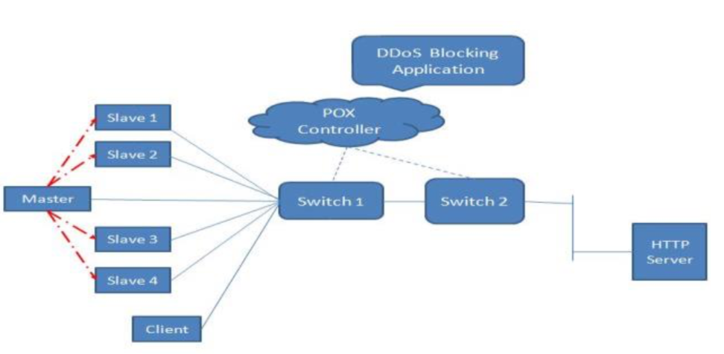
Simulation/Emulation Details [Network Topology]
Image Source: Google
Architecture consisting of Master, Slaves, Switches,
DDoS Blocking App running on POX and a HTTP Server

Slide 13
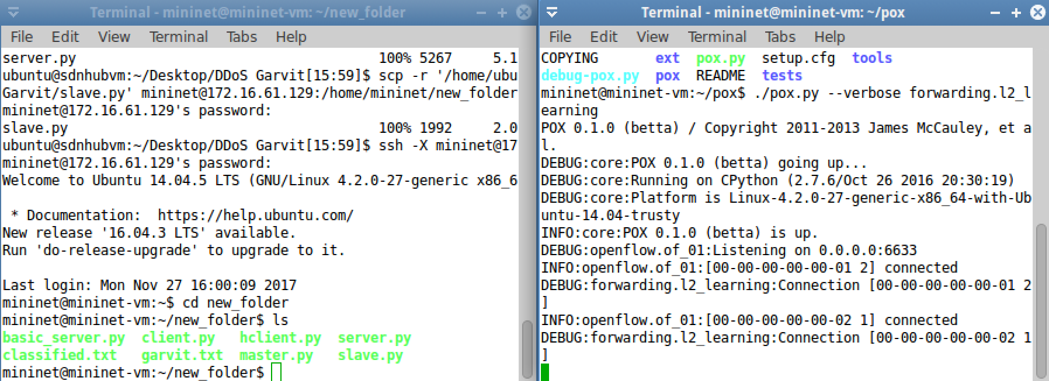
Simulation/Emulation Details (Environment and Setup)
The above picture shows the various python files and the “garvit.txt” and “classified.txt”
file which the client will access from the server. If clients try to access “classified.txt”, he can be one of the hacker and his IP and MAC address will be blocked.

Slide 14
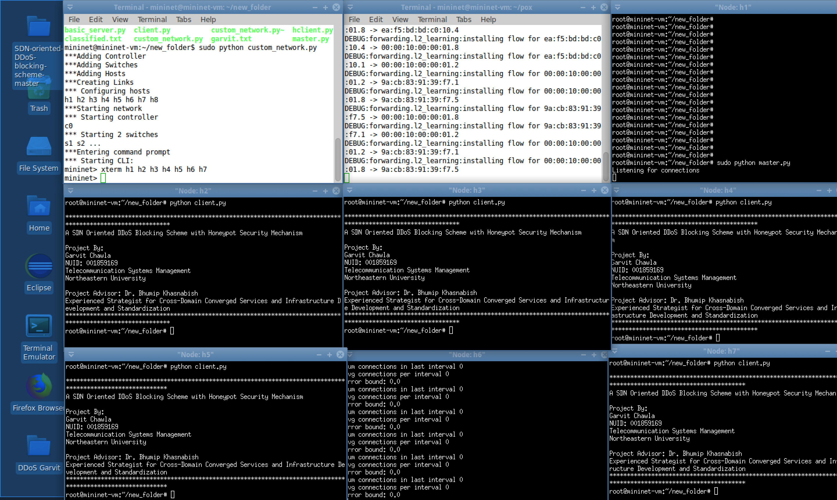
Simulation/Emulation Details (Tools and Monitoring Options)
This shows the various hosts.
H1 = Master, H2 – H5 = Slaves, H6 – Server, H7 = Legitimate Host.
The first window runs the custom network topology while the second window runs the pox controller as a basic learning switch.

Slide 15
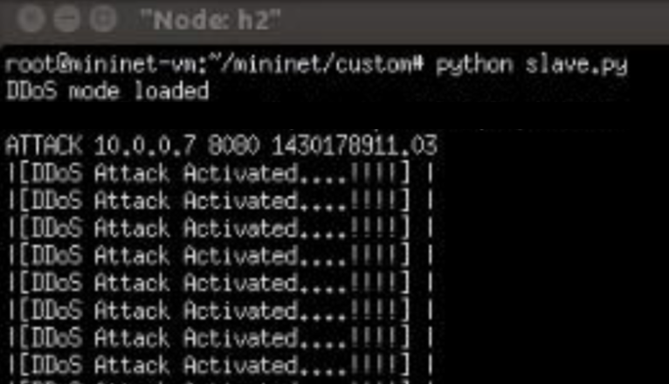
Simulation/Emulation Details [Adjustment(s), Adaptations, etc.]
All the hosts from H2 – H5 get connected to H1 master. After the connection is setup,
The Master (H1) tells the slaves(H2 – H5) to ask for ”garvit.txt” again and again. Each Slave now shows that “DDoS Attack Activated”, as they all are now connected to the Master.

Slide 16
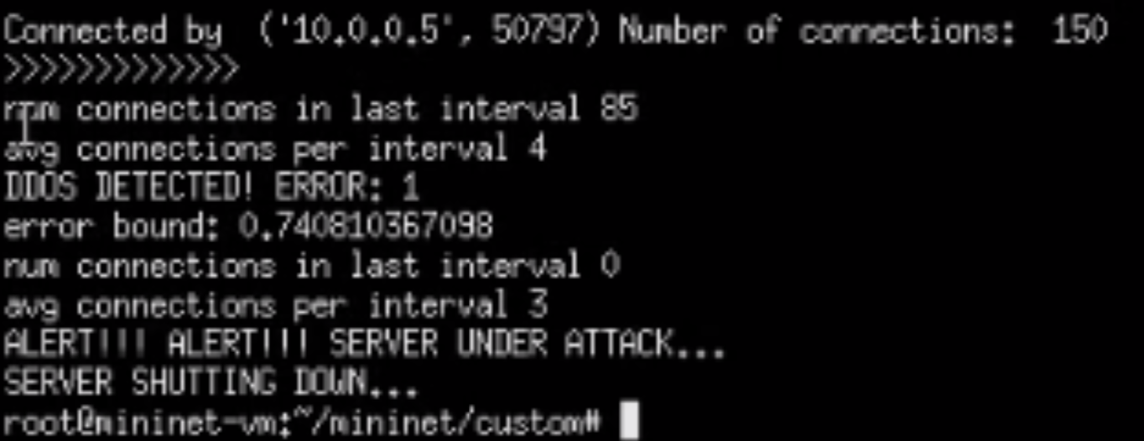
Simulation/Emulation Details [Adjustment(s), Adaptations, etc.]
The Number of Connections: 150 here. This is because the Master asked the slaves
(h2-h5) to ask for the “garvit.txt” file again and again.
Due to this Huge increase in traffic from several hosts all together, uses all the server
Resources and server understands that it’s under a DDoS attack.

Slide 17
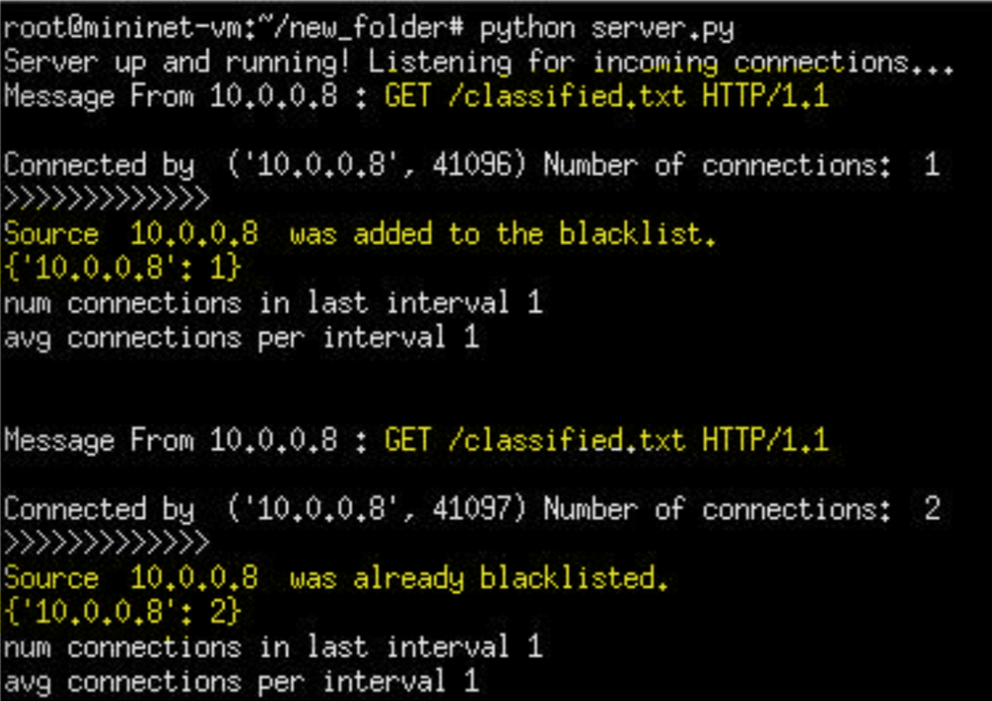
Simulation/Emulation Details [Host 7 Blacklisted]
Now, one of the Slave (10.0.0.8) asks for the ”classified.txt” file from the server.
The Server receives the “GET” request and then blacklists 10.0.0.8 and the MAC address of the Host/Slave.

Slide 18
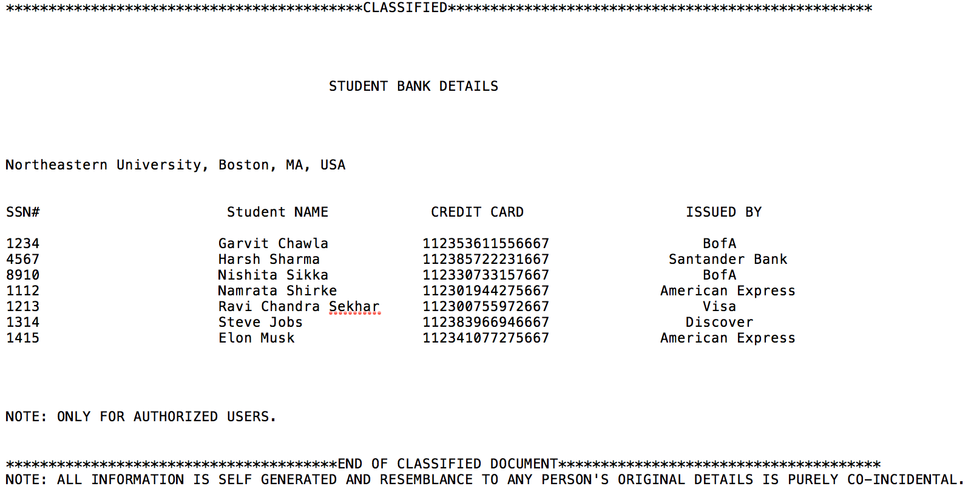
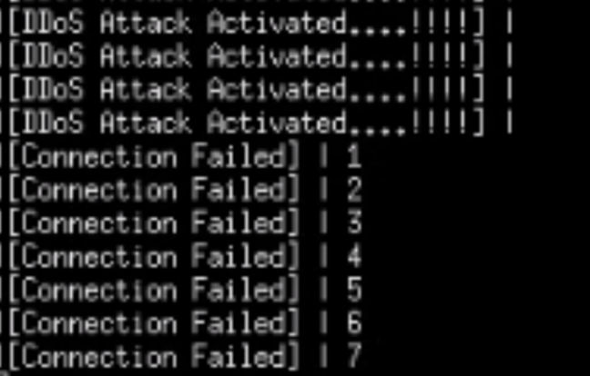
Simulation/Emulation Details [Honeypot “classified.txt” file]
Now, this is my honeypot file. The name is “classified.txt” and contains bank information
of students of this class. This file of a data which appears to be legitimate part of the site, but is actually isolated and monitored.

Slide 19
Simulation/Emulation Details [Results]
Now, the Slave (10.0.0.8) which asked for the honeypot “classified.txt” file from the
server gets a ”Connection Failed” when it tries to connect to the Server.

Slide 20
Results
In this project, a DDoS attack detection and mitigation application has been implemented in an SDN environment.
Additionally, a mechanism is developed on the server side to discern between legitimate and illegitimate users such that service to legitimate users is not affected.

Slide 21
Future Works
I would integrate my project with another research so as to add CAPTCHA, reCAPTCHA and Javascript challenge. So, that those who are considered as bots can prove their authenticity again.
I would make a similar version on java, so as to add features which are easy to develop on java-based OpenFlow controller like Floodlight.
I would like to add statistical data, so as to know how much data a host really uses at a particular time, so as to get an insight on the consumption of data and to make the DDoS Blocking scheme more efficient in working.
Applying more security mechanism other than Honeypot security mechanism I applied here.
Put the python codes on github. Ask for help/guidance from various researchers and students who have worked on a similar project.

Slide 22





Q&A and Discussion
Thanks for Your KIND Attention
Discussion

Slide 23
References
R. Braga, E. mota, and A. Passito, “Lightweight DDoS Flooding Attack Detection Using NOX/OpenFlow,” Proc. IEEE LCN, pp. 408-415, 2010.
Lim, S.; Ha, J.; Kim, H.; Kim, Y.; Yang, S., "A SDN-oriented DDoS blocking scheme for botnet-based attacks," Ubiquitous and Future Networks (ICUFN), 2014 Sixth International Conf on , vol., no., pp.63,68, 8-11 July 2014.
S. Shin et al., “FRESCO: Modular Composable Security Services for Software-Defined Networks,” Proc. ISOC NDSS, 2013.

